Slide 1

Heat and Thermodynamics
Md. Anisur Rahman
Assistant Professor (Physics)
University of Asia Pacific
Dhaka, Bangladesh

Slide 2
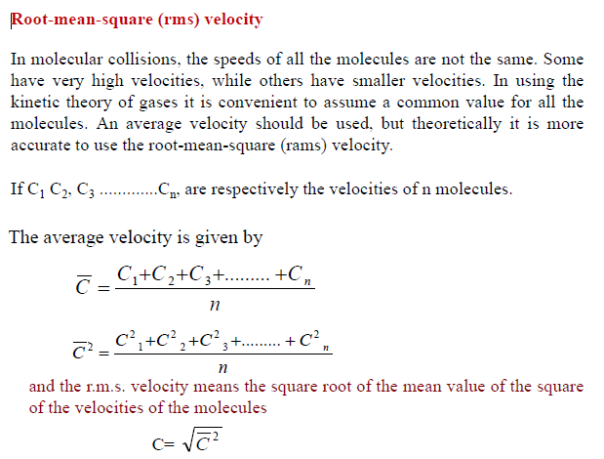

Slide 3
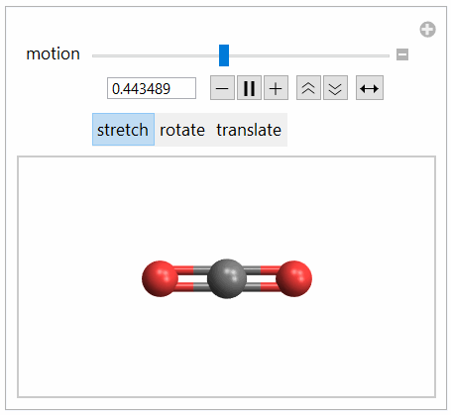
Degrees of Freedom
Degrees of freedom mean the number of independent variables that must be known to describe the state or the position of the body completely.
A monoatomic gas molecule has three degrees of freedom. A diatomic gas molecule has three degrees of freedom of translation and two degrees of freedom of rotation. It has in all five degrees of freedom.

Slide 4
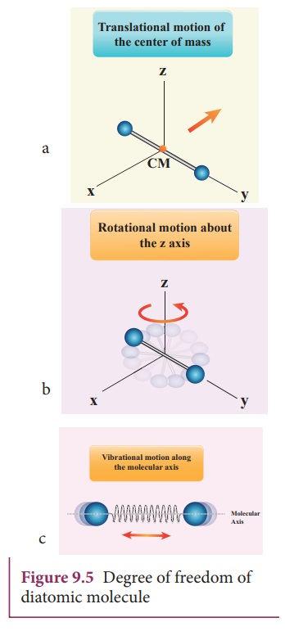
Maxwell’s Law of Equipartition of Energy
The name "equipartition" means "share and share alike". The equipartition theorem is also known as the law of equipartition, equipartition of energy, or simply equipartition. The original idea of equipartition was that, in thermal equilibrium, energy is shared equally among its various forms; for example, the average kinetic energy in the translational motion of a molecule should equal the average kinetic energy in its rotational motion.

Slide 5
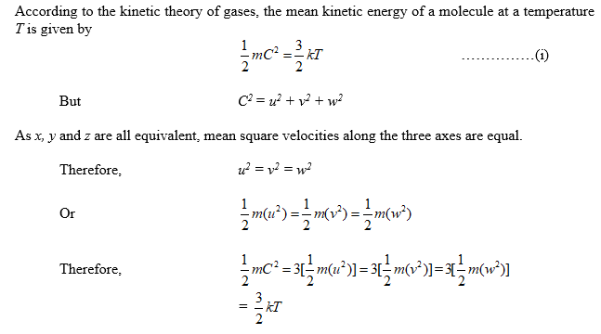

Slide 6
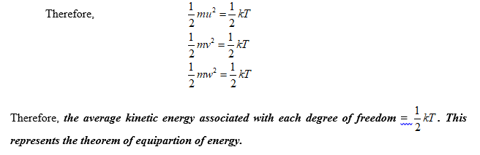

Slide 7
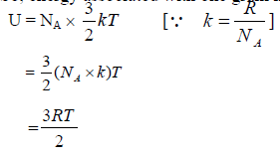
Specific Heat
Mono-atomic gas
A mono-atomic gas molecule has only one atom. Each molecule has three degrees of freedom.
The energy associated with each degree of freedom is 1/2 kT and for three degree of freedom is 3/2 kT. Consider one gram molecule of a gas contains N_{A} no of atoms. So, energy associated with one gram molecule of a gas is

Slide 8
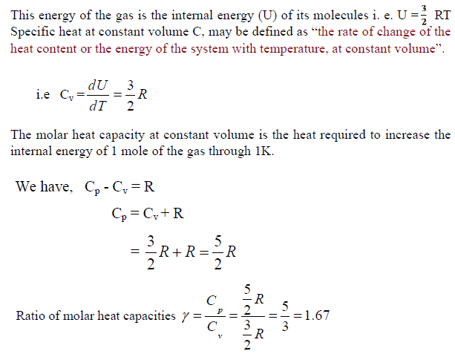

Slide 9
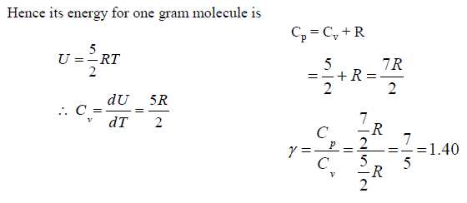
Diatomic gas
A diatomic gas molecule consists of two atoms. It has three degrees of freedom of translation and two degrees of freedom of rotation. O₂, H₂, N₂, CO etc. are the examples of diatomic gas. The energy associated for five degrees of freedom is 5/2 kT.

Slide 10
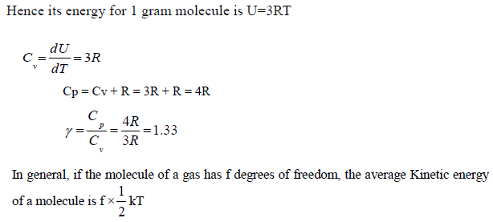
Tri atomic or Poly-atomic gas
A triatomic gas molecule consists of three atoms. This molecule has six degree of freedom (i.e. three translations three rotational).

Slide 11
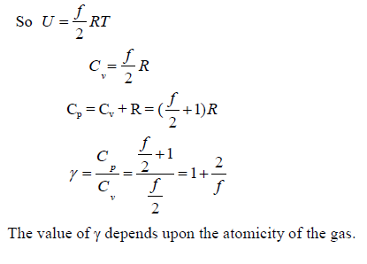

Slide 12
Phase
A phase is a form of matter that is homogeneous in chemical composition and physical state. Typical phases are solid, liquid and gas.
Phase Transition
A change in a feature of a physical system that results in a discrete transition of that system to another state. For example, the melting of ice is a phase transition of water from a solid phase to liquid phase.
Triple Point
The only point at which all three phases may exist in equilibrium is the triple point. In thermodynamic, the triple point of a substance is the temperature and pressure at which the three different phases, such as gaseous, liquid and solid of that substance coexist in thermodynamic equilibrium.

Slide 13

The unique combination of pressure and temperature at which liquid water, solid ice, and water vapor coexist in a stable equilibrium is approximately 273.16±0.0001 K and a vapor pressure of 611.657 pascals (6.11657 mbar; 0.00603659 atm).
For example, the triple point of mercury occurs at a temperature of −38.8 °C (−37.8 °F) and a pressure of 0.165 mPa.
Water boiling at 0°C using a vacuum pump.

Slide 14
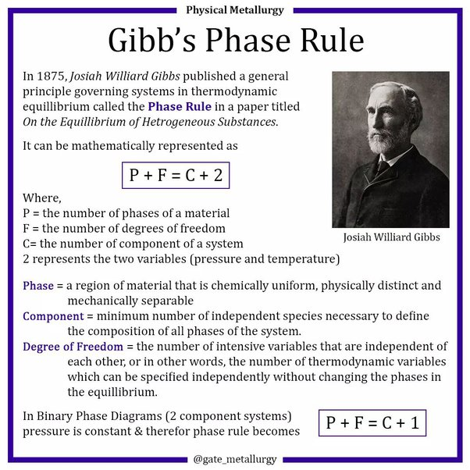

Slide 15


